Slide 1
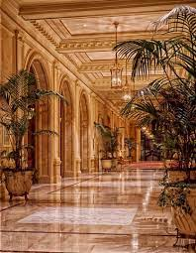
Hotel review classification
Team - 3

Slide 2
Agenda
This is a sample dataset which consists of 20,491reviews and ratings for different hotels and our goal is to examine how travelers are communicating their positive and negative experiences in online platforms for staying in a specific hotel.
Notes:
And we have to help the manager what are the positive attributes customers are telling about the hotel and what are the negative attributes the hotel has to improve hotel brand image

Slide 3
Important libraries
Pandas
Numpy
Matplotlib.pyplot
Spacy
en_core_web_sm
Wordcloud
Countvectoriser
Nltk
stopwords
Notes:
These are some of the libraries we have used for text preprocessing and for understanding the dataset

Slide 4
Data set details
20491 rows
2 columns

Slide 5
Exploratory data analysis
Look for problems in the data such as Visualization, missing value handling, outlier detection, skewness removal etc.
Treat all the problems with appropriate techniques

Slide 6
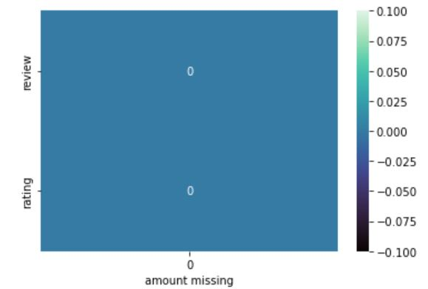
Missing values
There are no missing values in the data set
There are no null values in the dataset
There are no duplicated in the dataset

Slide 7
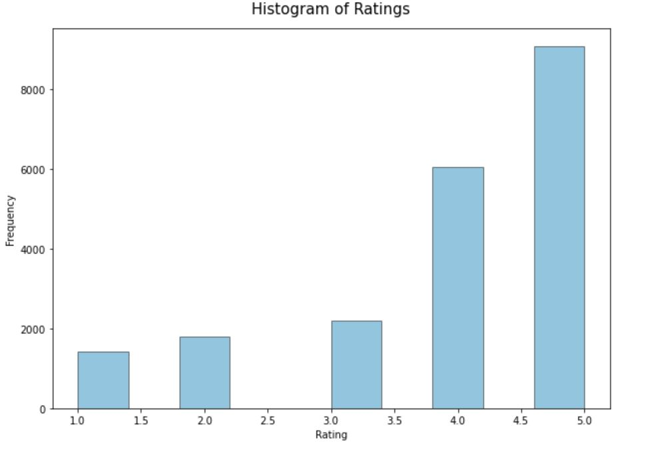
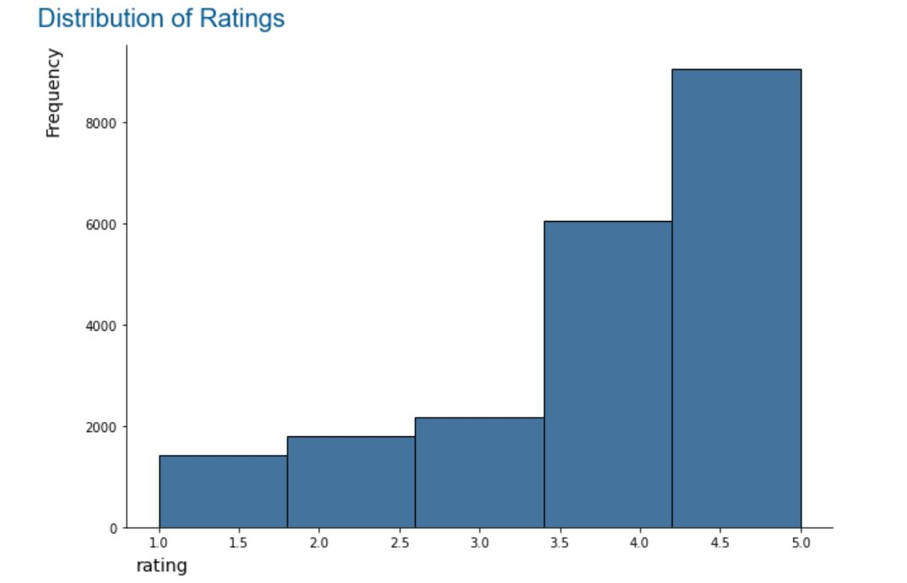
Histograms
Notes:
From these plot, we get to know that the 4 and 5 ratings are more and hence the hotel is performing well

Slide 8
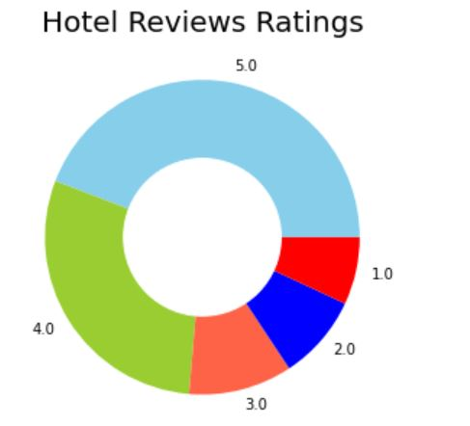
Pie chart
By looking the pie chart we can understand what are the negative,possitive,neutral comments
# Negative= 1-2
# Neutral = 3
# Possitive = 4-5

Slide 9
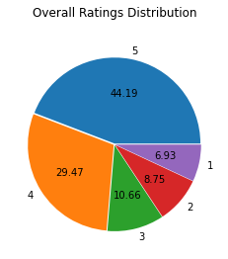
Total Distribution of all Ratings
Notes:
From this, we got to know that the 73% of the ratings are 4 and 5. or positive. So we can also tell around 73% of the people who have rated are happy with this hotel

Slide 10
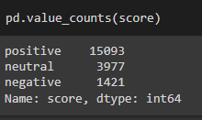
Value counts of Score

Slide 11
Word count and char count
 |  | score | Review | word_count | char_coun
 | 0 | positive | nice hotel expensive parking got good deal sta... | 89 | 593
 | 1 | neutral | ok nothing special charge diamond member hilto... | 252 | 1689
 | 2 | neutral | nice rooms not 4* experience hotel monaco seat... | 219 | 1427
 | 3 | positive | unique, great stay, wonderful time hotel monac... | 91 | 600
 | 4 | positive | great stay great stay, went seahawk game aweso... | 193 | 1281
Notes:
We have checked what are the word count and character count for each rating

Slide 12
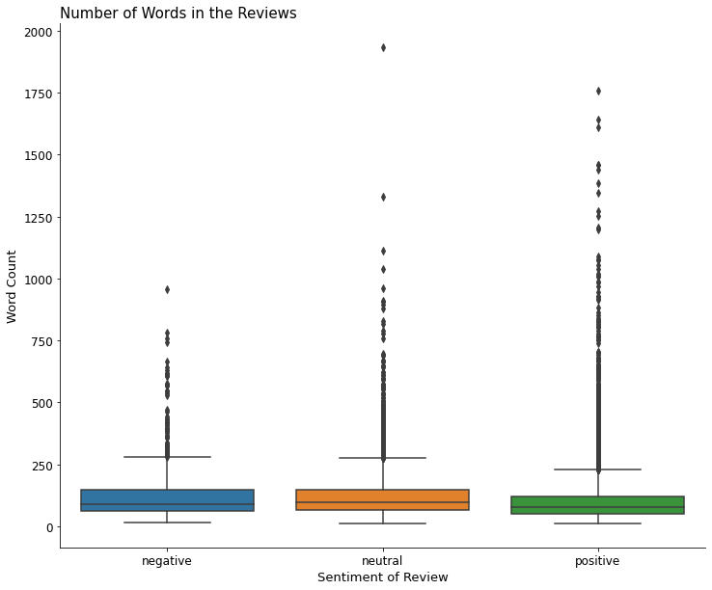
Number of words in reviews using boxplot

Slide 13
Text pre processing

Slide 14
Important libraries
Import re
import nltk
from nltk.corpus import stopwords
from nltk.corpus import wordnet
from nltk.stem import WordNetLemmatizer
from nltk.tokenize import word_tokenize
from textblob import TextBlob
from spellchecker import SpellChecker
from emot.emo_unicode import UNICODE_EMOJI
from emot.emo_unicode import EMOTICONS_EMO

Slide 15
Creating copy text of original data
 | score | Review | Review_cln
0 | positive | nice hotel expensive parking got good deal sta... | nice hotel expensive parking got good deal sta...
1 | neutral | ok nothing special charge diamond member hilto... | ok nothing special charge diamond member hilto...
2 | neutral | nice rooms not 4* experience hotel monaco seat... | nice rooms not 4* experience hotel monaco seat...
3 | positive | unique, great stay, wonderful time hotel monac... | unique, great stay, wonderful time hotel monac...
4 | positive | great stay great stay, went seahawk game aweso... | great stay great stay, went seahawk game aweso...

Slide 16
Make text lower case
0 nice hotel expensive parking got good deal sta...
1 ok nothing special charge diamond member hilto...
2 nice rooms not 4* experience hotel monaco seat...
3 unique, great stay, wonderful time hotel monac...
4 great stay great stay, went seahawk game aweso...
5 love monaco staff husband stayed hotel crazy w...
6 cozy stay rainy city, husband spent 7 nights m...
7 excellent staff, housekeeping quality hotel ch...
8 hotel stayed hotel monaco cruise, rooms genero...
Notes:
In the text preprocessing part we normalise the text data by using .lower() function

Slide 17
Remove punctuation marks
0 nice hotel expensive parking got good deal sta...
1 ok nothing special charge diamond member hilto...
2 nice rooms not 4 experience hotel monaco seat...
3 unique great stay wonderful time hotel monac...
4 great stay great stay went seahawk game aweso...
5 love monaco staff husband stayed hotel crazy w...
6 cozy stay rainy city husband spent 7 nights m...
7 excellent staff housekeeping quality hotel ch...
Notes:
Then we removed some of the special characters like * and # from the text

Slide 18
Remove numbers and white spaces
0 nice hotel expensive parking got good deal sta...
1 ok nothing special charge diamond member hilto...
2 nice rooms not experience hotel monaco seattle...
3 unique great stay wonderful time hotel monaco ...
‘4 great stay great stay went seahawk game awesom...
5 love monaco staff husband stayed hotel crazy w...
6 cozy stay rainy city husband spent nights mona...
7 excellent staff housekeeping quality hotel cho...
Notes:
Also removed the digits and white spaces as they do not contribute for analysing

Slide 19
Normalisation & Lemmatisation
Lemmatization converts word to base form based on context. It is more accurate than stemming.

Slide 20
Remove stopwords
nice hotel expensive parking get good deal sta...
ok nothing special charge diamond member hilto...
nice room experience hotel monaco seattle good...
unique great stay wonderful time hotel monaco ...
great stay great stay go seahawk game awesome ...
love monaco staff husband stay hotel crazy wee...
cozy stay rainy city husband spend night monac...
Notes:
After tokenisation, we remove the words which don’t contribute for the analysis which are also called as stopwords

Slide 21
Lemmatisation
nice hotel expensive parking get good deal sta...
ok nothing special charge diamond member hilto...
nice room not experience hotel monaco seattle ...
unique great stay wonderful time hotel monaco ...
great stay great stay go seahawk game awesome ...
love monaco staff husband stay hotel crazy wee...
cozy stay rainy city husband spend night monac...
Notes:
Then we do lemmatisation. As stemming is brutally chopping the words, it doesn’t give meaningfull words. But lemmatization gives gives meaningful root words

Slide 22
Frequently used words
'bedpillows',
'qld',
'donette',
'citylife',
'imp',
'unfort',
'morrisey',
'cultery',
Notes:
After that we extracted these most frequently used words in the reviews.

Slide 23
Text insights and analysis

Slide 24
Important libraries
import seaborn as sns
from wordcloud import WordCloud, ImageColorGenerator, STOPWORDS
from sklearn.feature_extraction.text import TfidfVectorizer
from nltk.tokenize import word_tokenize
from nltk import FreqDist, bigrams
import nltk.collocations as collocations
import nltk

Slide 25
Possitive reviews
'nice hotel expensive parking get good deal stay hotel anniversary arrive late evening take advice previous review valet park check quick easy little disappointed non existent view room room clean nice size bed comfortable woke stiff neck high pillow soundproof like heard music room night morning loud bang door open closing hear people talk hallway maybe noisy neighbor aveda bath product nice goldfish stay nice touch take advantage stay long location great walk distance shop overall nice experience pay park night unique great stay wonderful time hotel monaco location excellent short stroll main downtown shop area pet friendly room show sign animal hair smell monaco suite sleep area big strip curtain pull closed nice touch felt cosy goldfish name brandi enjoy n partake free wine coffee tea service lobby think great feature great staff friendly free wireless internet hotel work suite laptop decor lovely eclectic mix patten color palatte animal print bathrobe feel like rock star nice n look like sterile chain hotel hotel personality excellent stay great stay great stay go seahawk game awesome downfall view building n complain roo

Slide 26
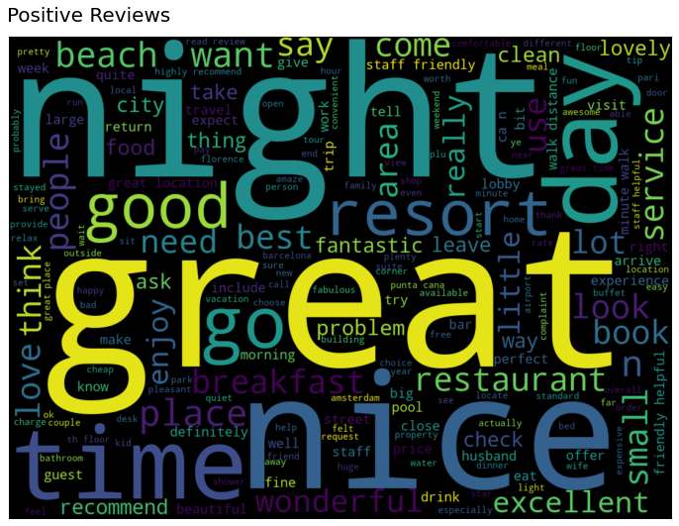
Word-cloud for positive reviews
Notes:
Nice,great, beach, night, location, food

Slide 27
Negative reviews
horrible customer service hotel stay february rd th friend pick hotel monaco appeal website online package include champagne late checkout free valet gift spa weekend friend check room hour earlier come later pull valet young man stand asked valet open say pull bag didn____ offer help get garment bag suitcase come car key room number say valet car park car street pull leave key work ask valet park car get go room fine bottle champagne oil lotion gift spa dress go come get bed notice blood drop pillow sheet pillow disgust unbelievable call desk sent somebody minute later swap sheet leave apologize sunday morning call desk speak management sheet aggravate rude apparently manager kind supervisor weekend wait monday morning young man speak say cover food add person change sheet say fresh blood rude tone checkout pm package book staff maid try walk room

Slide 28
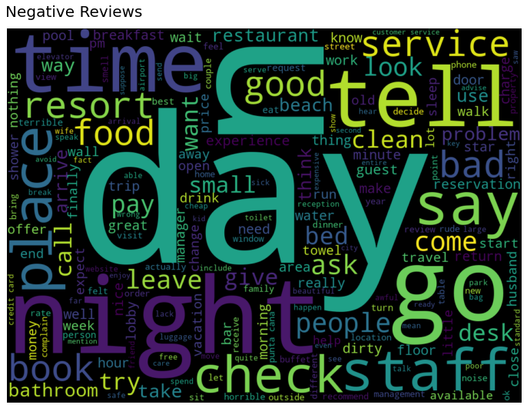
Wordcloud for negative reviews
Notes:
Reservation, towel, bed, dinner, water, price, bathroom,

Slide 29
Term Frequency & Inverse Document Frequency (TF-IDF)

Slide 30
Positive Reviews TF-IDF
'nice hotel expensive parking get good deal stay hotel anniversary arrive late evening take advice previous review valet park check quick easy little disappointed non existent view room room clean nice size bed comfortable woke stiff neck high pillow soundproof like heard music room night morning loud bang door open closing hear people talk hallway maybe noisy neighbor aveda bath product nice goldfish stay nice touch take advantage stay long location great walk distance shop overall nice experience pay park night',
'unique great stay wonderful time hotel monaco location excellent short stroll main downtown shop area pet friendly room show sign animal hair smell monaco suite sleep area big strip curtain pull closed nice touch felt cosy goldfish name brandi enjoy n partake free wine coffee tea service lobby think great feature great staff friendly free wireless internet hotel work suite laptop decor lovely eclectic mix patten color palatte animal print bathrobe feel like rock star nice n look like sterile chain hotel hotel personality excellent stay',
Notes:
In TfidfVectorizer we consider overall document weightage of a word. And it helps to convert text into vector form which helps in the model building part

Slide 31
Positive TF-IDF
TF-IDF
nice | 0.259657
goldfish | 0.211275
stiff | 0.201279
woke | 0.199928
neck | 0.195125
closing | 0.194050
existent | 0.193017
park | 0.179413
soundproof | 0.175270
aveda | 0.170553
bang | 0.169289
Notes:
Top ten frequently occurred words in positive reviews

Slide 32
Negative Reviews TF-IDF
'horrible customer service hotel stay february rd th friend pick hotel monaco appeal website online package include champagne late checkout free valet gift spa weekend friend check room hour earlier come later pull valet young man stand asked valet open say pull bag didn____ offer help get garment bag suitcase come car key room number say valet car park car street pull leave key work ask valet park car get go room fine bottle champagne oil lotion gift spa dress go come get bed notice blood drop pillow sheet pillow disgust unbelievable call desk sent somebody minute later swap sheet leave apologize sunday morning call desk speak management sheet aggravate rude apparently manager kind supervisor weekend wait monday morning young man speak say cover food add person change sheet say fresh blood rude tone checkout pm package book staff maid try walk room open door apologize closing people call say check remind package finally pack thing go downstairs check quickly sign paper take way take close look room unfortunately cover food offer charge valet call desk ask charge lady answer snap say aware problem experience monday like tell earlier life treat like hotel sure hotel constantly problem lucky one stay recommend anybody know',
'noise airconditioner standard arrange stay travel agency unfortunately warwick seattle hotel dissapointment trip night stay warwick change room start minute stay hotel personnel make feel like guest like intruder reluctant help solve complaint hotel right downtown minute really good restaurant like good thing availability room offer nd floor window directly open car park level change room room loud sound come air conditioner heat unbelievable hotel hotel personnel tell standard noise room try avoid use night order sleep possible watch tv loudly',

Slide 33
Negative TF-IDF
TF-IDF
valet | 0.371706
car | 0.205206
sheet | 0.192908
pull | 0.182745
package | 0.181760
say | 0.166347
monday | 0.149243
champagne | 0.142799
gift | 0.141400
Notes:
Top ten frequent words in the negative reviews

Slide 34
Bag of words

Slide 35
Positive bag of words
('hotel', 38835)
,('room', 30974),
('stay', 19521),
('great', 17970),
('good', 13203),
('staff', 12672),
('n', 12314),
('night', 9796),
('nice', 9451),

Slide 36
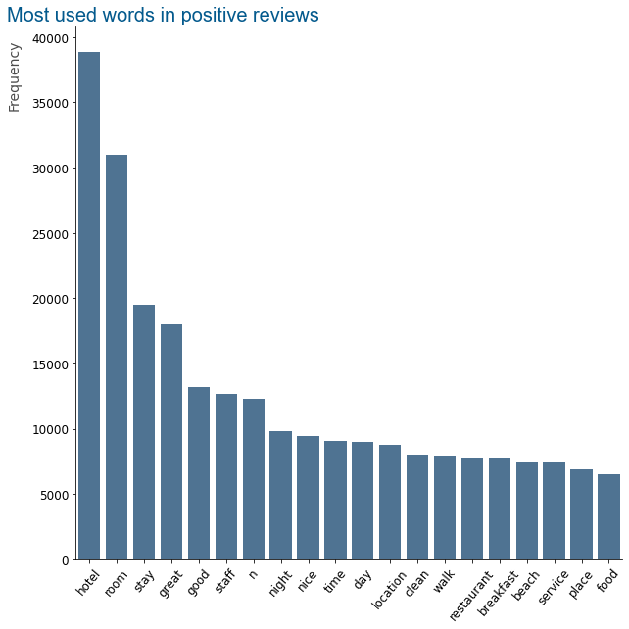
Bar graph for most used words in possitive reviews
Notes:
Here we ploted most frequent words in the dataset

Slide 37
Negative review bag of words
('room', 4162),
('hotel', 3857),
('stay', 1879),
('n', 1631),
('day', 1212),
('night', 1158),
('staff', 965),
('time', 903),

Slide 38
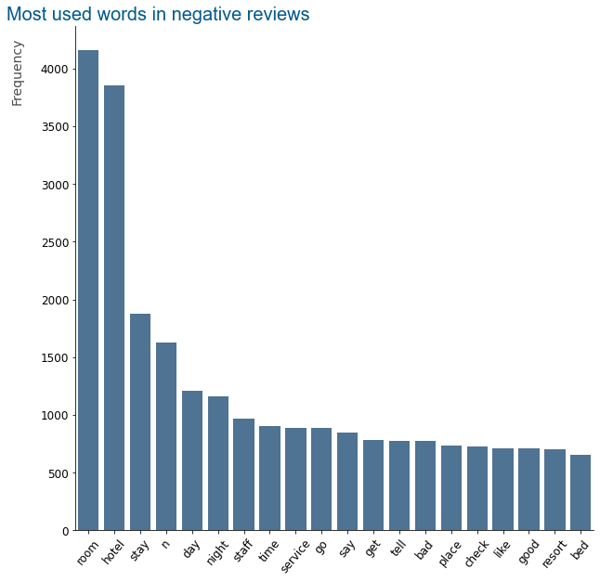
Bar graph for most used words in negative reviews
Notes:
Top 10 frequent words in negative reviews

Slide 39
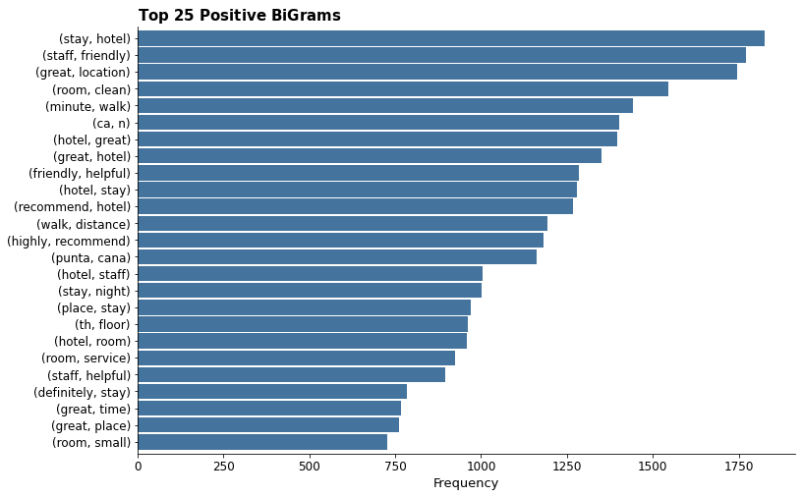
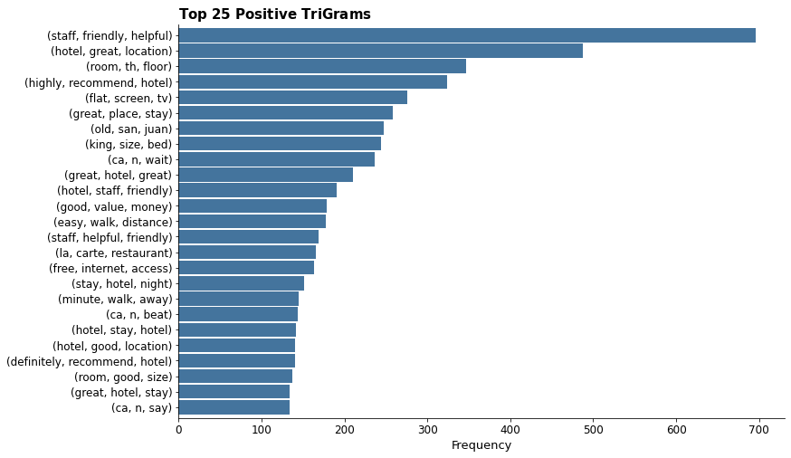
Bigrams & Trigrams

Slide 40
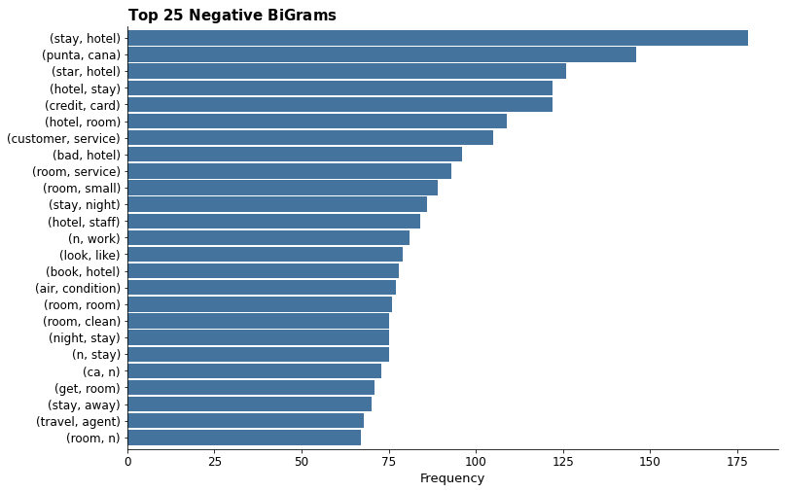

Bigrams & Trigrams

Slide 41
Model building

Slide 42
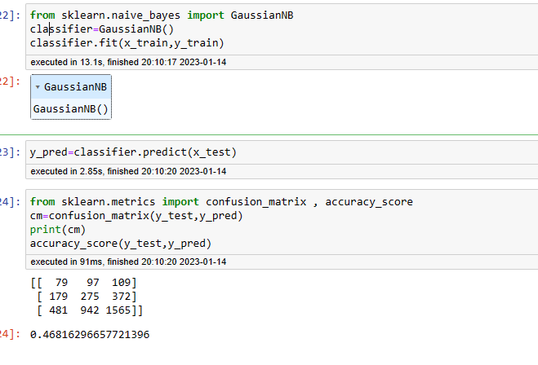
Naive Bayes

Slide 43
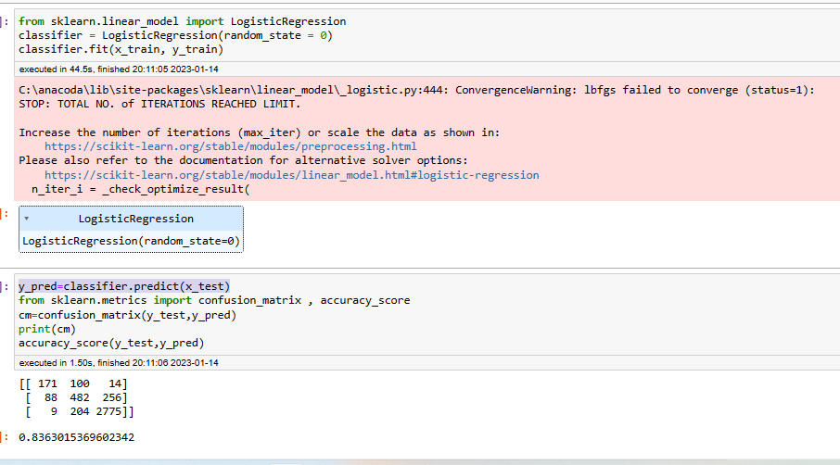
Logistic Regression

Slide 44
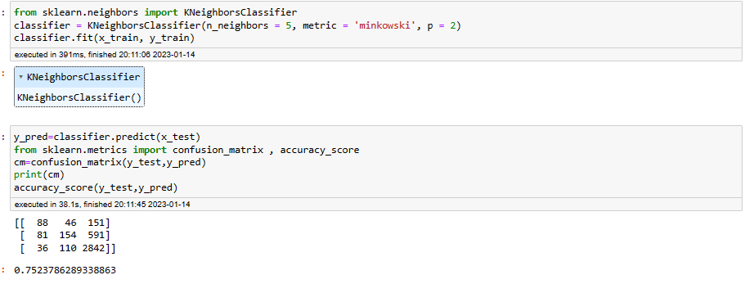
KNN Algorithm

Slide 45
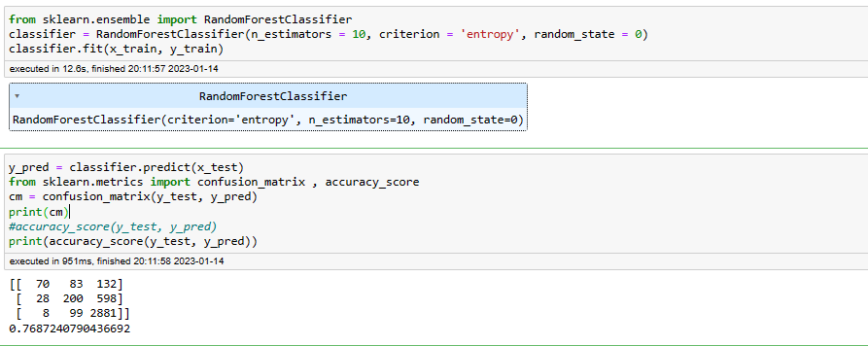
Random Forest Algorithm

Slide 46
Deployment

Slide 47
Flask web app
First step is to install Flask in either anaconda prompt or anaconda powershell prompt using the code “pip install flask” based on your OS..
Go to prompt and enter the folder name where the file has been saved using “cd ‘folder name’” and run it.
Run the entire code using “ python hotel.py file” and we will get https web local host will be created
Copy the above link and paste it in the chrome

Slide 48
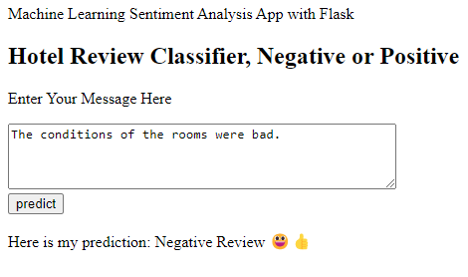
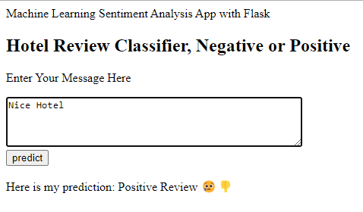
After running the code the output is going to be like this
Then we need to enter the review then it will predict the review as positive or negative

Slide 49
Thank You
-Srinu Guddala
-Prajyna PralhadraoKulkarni
-Akshata Arun Bhosale
-Tushar Ranjan Panda
-Sanjeev Kumar
-Balram Randheer Singh
-D.Sheshidhar Reddy

